Slide 1
Pan-Westminster Patient Participation Group
October 2024 Meeting
October 2024
Patchs

Slide 2
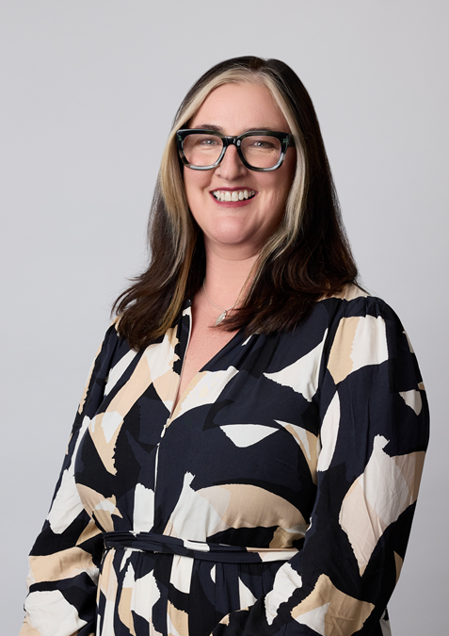
Welcome!
Kirstie Black,
PPG meeting chair,
Managing Director & Board Member, Healthcare Central London

Slide 3


Code of Conduct
Housekeeping
1) The PPG meeting is not a forum for individual complaints and personal issues.
2) All views are valid and will be listened to.
3) Respect the practice and patient confidentiality at all times.
4) Open and honest communications apply to all.
5) Discrimination on any grounds will not be tolerated.
6) Silence indicates agreement- speak up if you would like your suggestions to be a part of the discussion.
7) Be flexible, listen, ask for help and support each other.
8) Demonstrate a commitment to delivering results as a group.
9) Start and finish meetings on time and stick to the agenda.
10) No phone or other disruptions.

Slide 4

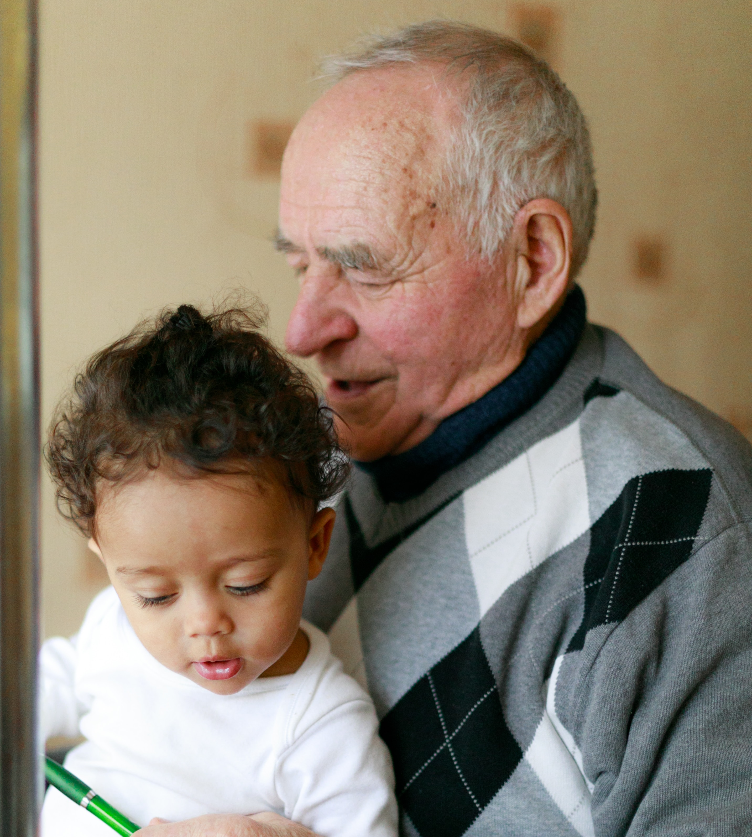

Pan-Westminster Patient Participation Group October 2024 Meeting Agenda
Item | Subject | Lead | Time
1 | Welcome to the HCL PPG and Housekeeping | KB | 17:30
2. | Review of Action Log | MT | 17:35
3. | Planned Telephony Cover | KA | 17:40
4. | Patchs: About Patchs When can we access Patchs Advanced Nurse Practitioners Accessing Patchs What is Patchs Translate Patient Journey The Growth of Patchs How to submit a Patchs | LD | 18:00
5. | Patient Access Survey | NK | 18:30
6. | Healthcare Central London Patient Feedback | KB | 18:45
7. | Any Other Business: Regent Health PCN Mental Health Awareness Fair | ALL | 18:55

Slide 5



Item 2: Review of Action Log
October 2024

Slide 6
Healthcare Central London Federation Pan-Westminster Patient Participation Group (PPG) meeting Action Log
Date | Subject | Action | Owner
09 July 2024 | July 2024 HCL PPG meeting | Practice Websites: Action: Project Lead to request feedback from Practices about their new websites | HW
09 July 2024 | July 2024 HCL PPG meeting | Project team to create communication to Practices raising awareness about the AA service | LD

Slide 7
Planned Telephony Cover
Item 3:

Slide 8

Planned Telephony Cover
Context
Access to General Practice is a longstanding challenge with increasing demand
Feedback from our Federation practices is for optional planned telephone cover
Support access and practice development - meetings, training and emergencies
HCL Care Coordinators take calls and log actions for the practice
Workshop
People
Transparency – tell patients they are speaking to HCL, not practice
Alert – pre-warn callers of events with a short phone message
Communication – inform patients via website, PPG, posters, texts
Process
Safety – ensure safety netting e.g. emergency red flags protocols
Scope – agree on which tasks to do and not do
SOP – standardised, uniform and consistent to remove variations
Products
Integration – HCL use same systems and are trained by practices
Governance – Robust quality and clinical safety assurance system
Data Security – HCL adheres to same NHS and GDPR standards
Service Design
Research – Scoping July 2024 – 20 Practice Managers responded to survey
Ideation – Workshop Sept 2024 – Stakeholders brainstormed and discussed ideas
Prototyping – Pilot Sept 2024 – Viability, risks, feedback and refine before full-scale
Implementation – Roll out Nov 2024 – Awaiting guidance from our steering groups
No. of Use | Total Calls Received | Calls / Hour | Total Calls Answered | Percentage Answered (%) | Total Calls Missed | Percentage Missed (%) | Total Calls Abandoned | Average Queued Time (Sec) | Average Talk Time (Sec)
12 | 172 | 7 | 165 | 96% | 7 | 4% | 17 | 53 | 129

Slide 9
Patchs
Item 4:

Slide 10

About Patchs
Making it easier for patients to access Primary Care is a big focus for Healthcare Central London (HCL). Patchs, our online GP Led appointments and triage system, helps our member Practices to manage patient requests more effectively.
Patchs does not replace existing methods of contact for our member Practices, patients are still able to call or visit.
NHS 111 is available when our member Practices and Patchs are closed.
Patients can submit a Patch for an admin query or submit a clinical Patch seeking care for their symptoms.
Files such as a letter or an image can be attached to a Patch. However, images of intimate areas should not be attached unless asked to do so by a clinician.
Patchs is not designed for life-threatening emergencies, patients are reminded of this before they start submitting a Patch.
For life-threatening emergencies, patients must call 999.

Slide 11

When Can We Access Patchs?
Patchs is available weekdays from 08:00 and submissions close at 18:30
Patchs is closed Bank Holidays, this is line with our member Practices
Patchs Team
GPs
Advanced Nurse Practitioners (ANPs)
Care Coordinators (Admin)
Supported by a GP Clinical Lead responsible for Clinical Governance
Supported by operations management

Slide 12
Advanced Nurse Practitioner Role
Not all patients are aware of the Advanced Nurse Practitioner role. You may hear the role referred to as ANP.
ANPs are highly trained health professionals who can undertake reviews of patients for many common presentations in general practice.
To become an ANP, an individual must be a fully qualified Registered Nurse and then undertake a separate 3-year Master’s Degree in Advanced Clinical Practice (or equivalent). During this time, ANPs undergo a minimum of 500 hours of clinical supervision with a GP or hospital Doctor.
HCL's ANPs come from several clinical backgrounds including urgent care, Accident & Emergency, acute medical/surgical backgrounds and general practice.
ANPs are also available in HCL's Additional Access and Enhanced Access services.
ANPs DO NOT consult the following:
  Acute mental health
  Children under 5 years
  Pregnant women

Slide 13
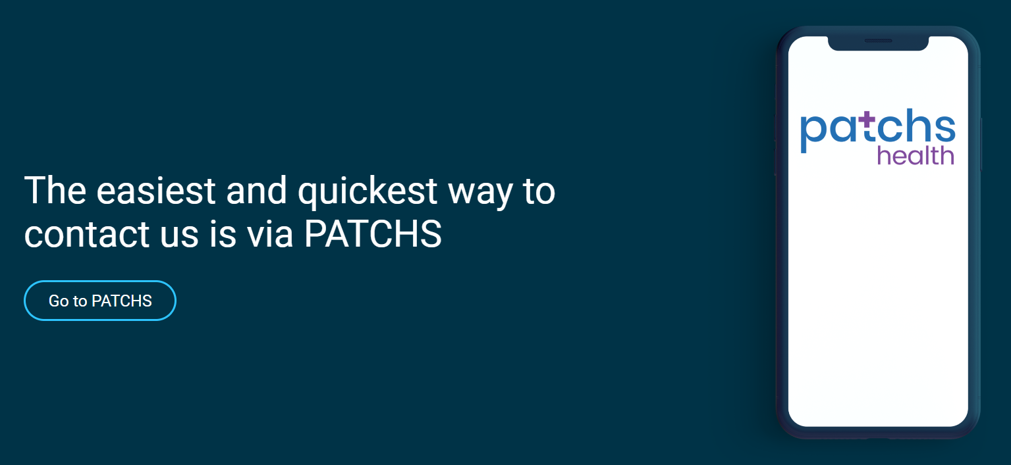
Accessing Patchs
Patchs is accessed via your GP practice's website by selecting 'Contact Us'. Alternatively, the web page can be bookmarked for convenience. Patients must be registered to submit a Patch.

Slide 14
What is Patchs Translate?
Patchs is primarily meant to be used in English. However, to make access to online consultations more equitable to patients who do not speak English as their first language, Patchs provides an optional translation service.
Patchs Translate is meant to facilitate communication with your GP practice, not replace it.
As of October 15th 2024, 32 languages are available including Arabic, Bengali, Bulgarian, Chinese, Gujarati, Hindi, Polish, Portuguese, Ukranian, Urdu and Welsh.
If Patchs Translate is not active when you're submitting a Patch via your GP practice's website, please contact your GP practice and request for it to be activated.

Slide 15
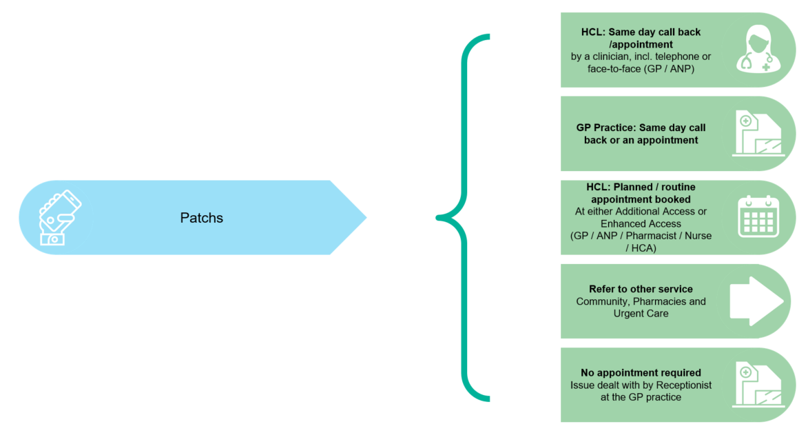
Patient Journey

Slide 16
The Growth of Patchs
Monthly average: 10,000 Patchs

Slide 17
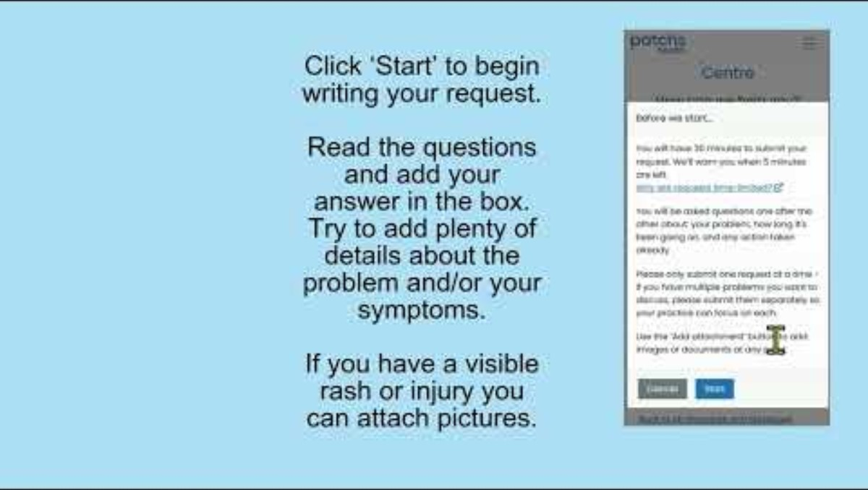
How to submit a Patch

Slide 18
ICB Patient Access Survey
Item 5:

Slide 19



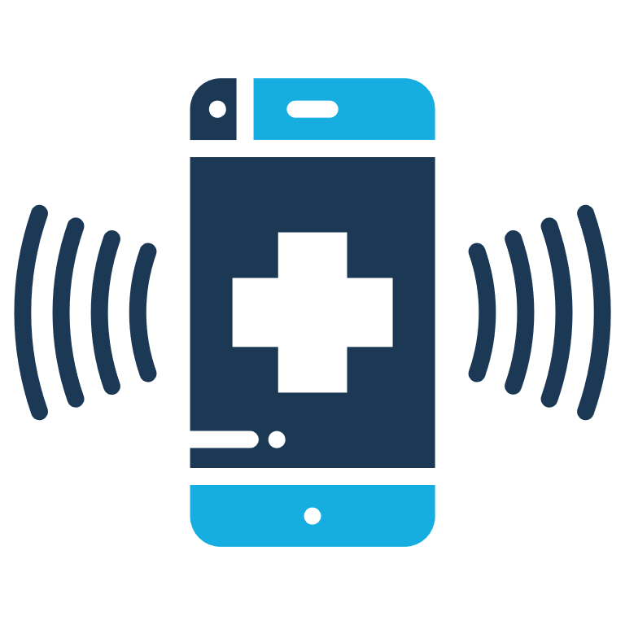
ICB Patient Access Survey
This survey is about finding out how easy or hard it is to access GP services. The survey is to run for two weeks from Monday 14th October. The target is a 5% response rate of all patients over 14 years old.
Current Progress
What do you think?
Link is up on all HCL managed websites (20)
Practices managing their own websites have also been shared the information and copy to add
Some considerations:
Promotional material and posters issued to practices
QR codes created to enable patients in practice to go to website instead of paper copy
Where should we promote the survey? (Physical locations/ Online)
Local organisations or meet-ups- where to look?
Voices outside of existing routes- who wouldn't reply to an online survey? Who doesn't use email/ sms?
Format- attend existing events vs Host specific events?
Next Steps
Explore our reach to patients via existing services such as Patchs, district nurses and Community Health and Wellbeing Workers (CHWWs)

Slide 20
Healthcare Central London Patient Feedback
Item 6:

Slide 21
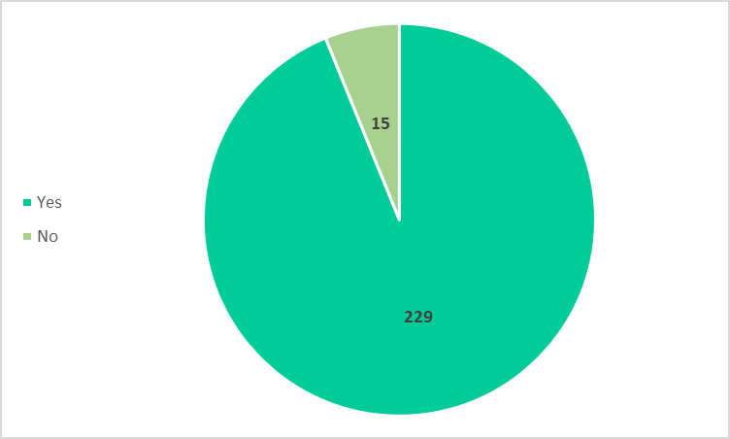
Friends & Family Patient Survey
Friends & Family Patient Survey
Additional Access: Would you recommend the service to your friends and family?
Additional Access: Would you recommend the service to your friends and family?
Patients are surveyed following an Additional Access appointment.
In August 2024, there were 1,268 appointments of which 86 patients provided feedback (7% response rate).
Overall, the service has had 244 patient feedback scores with 229 patients recommending it to Friends and Family (94% recommendation). Additional Access went live Feb 2024.
Patients are surveyed following an Additional Access appointment.
In August 2024, there were 1,268 appointments of which 86 patients provided feedback (7% response rate).
Overall, the service has had 244 patient feedback scores with 229 patients recommending it to Friends and Family (94% recommendation). Additional Access went live Feb 2024.

Slide 22
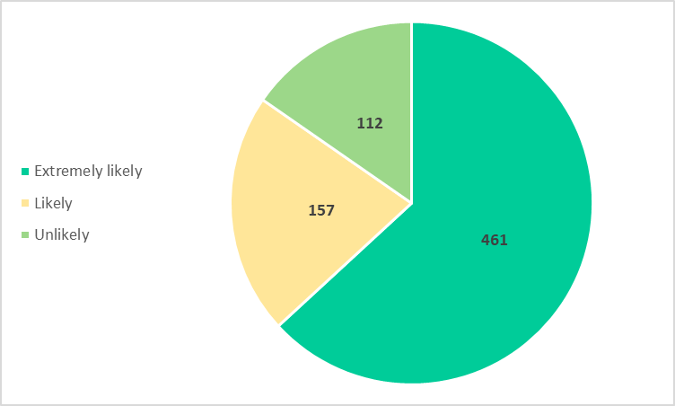
Friends & Family Patient Survey
Enhanced Access: Would you recommend the service to your friends and family?
Patients are surveyed following an Enhanced Access appointment.
In August 2024, there were 3,163 appointments of which 41 patients provided feedback (1.3% response rate).
Overall, the service has had 1,143 patient feedback scores with 967 patients recommending it to Friends and Family (85% recommendation).

Slide 23
Any other Business:
​
Regent Health PCN Mental Health Awareness Fair ​
Next meeting15th January 2025 & 17:30 - 19:00 ​and venue TBC ​

Slide 24
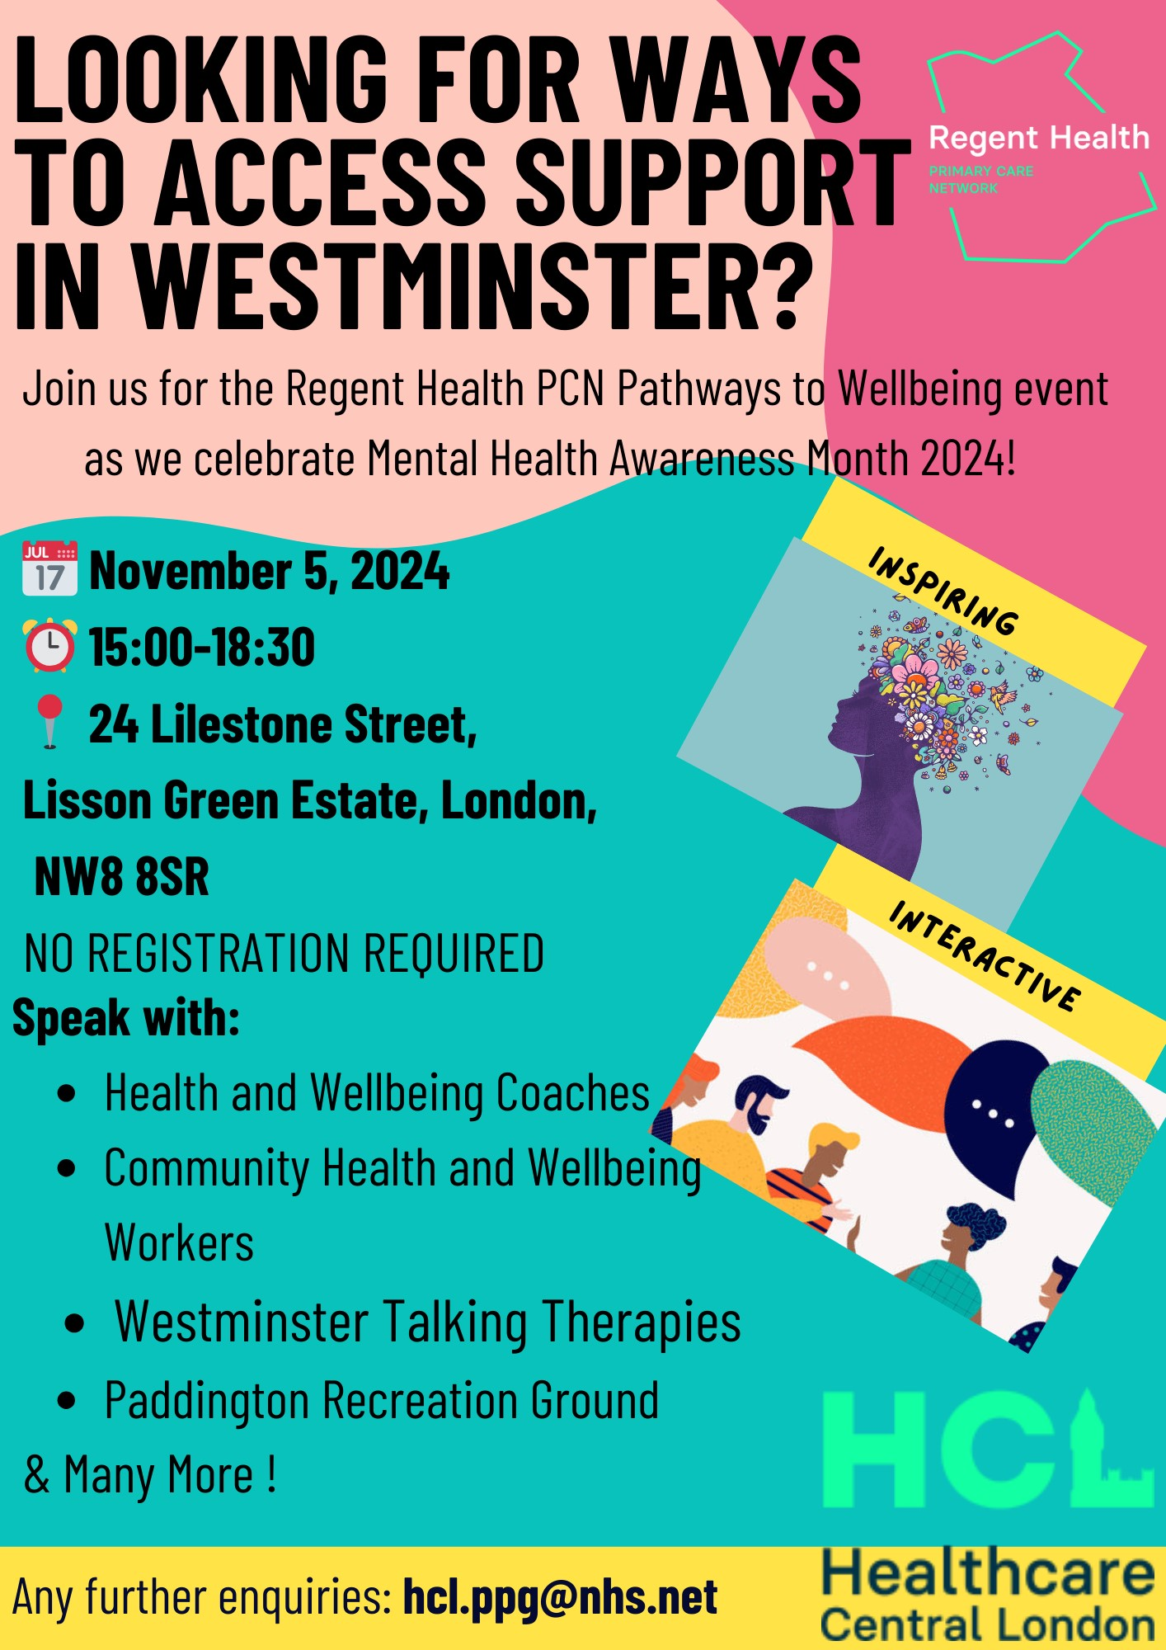
Regent Health PCN Mental Health Awareness Fair ​

Slide 25


Thank you for coming!
The next meeting is on 15th January 2025 and location is TBC.
Please send any queries to hcl.ppg@nhs.net

